Slide 1
UNIT 4 MEMORY MANAGEMENT

Slide 2
Background
Program must be brought (from disk) into memory and placed within memory for it to be run
Main memory and registers are only storage CPU can access directly
Register access in one CPU clock (or less)
Main memory can take many cycles

Slide 3
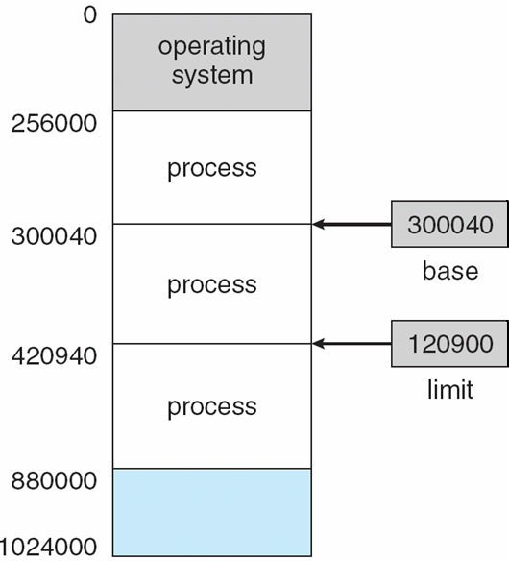
Base And Limit Registers
A pair of base and limit registers define the physical address space

Slide 4
Logical Vs. Physical Address Space
Logical address – generated by the CPU; also referred to as virtual address.
Physical address – address seen by the memory unit.
Logical and physical addresses are the same in compile-time and load-time address-binding schemes; logical (virtual) and physical addresses differ in execution-time address-binding scheme

Slide 5
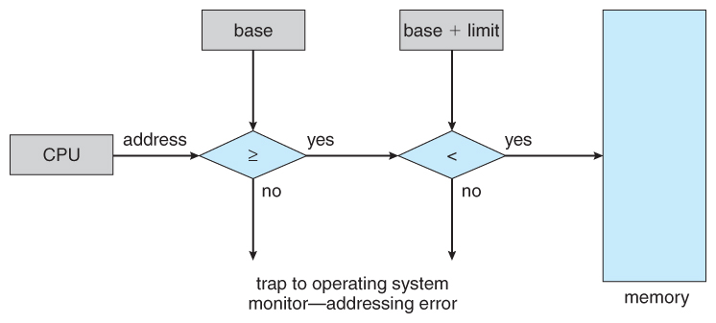
Hardware Address Protection With Base And Limit Registers

Slide 6
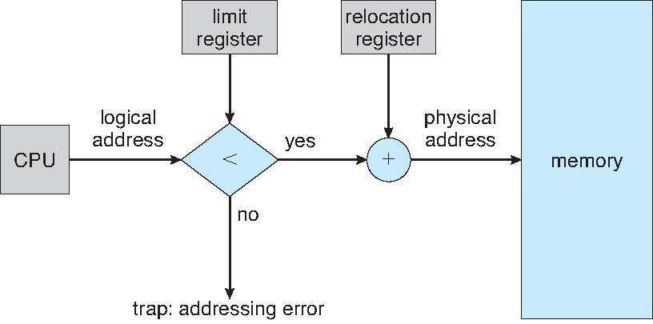
Hardware Support For Relocation And Limit Registers
s
Notes:
The address generated by the CPU is a logical address which is not known to the Main Memory. The Physical memory or the Main Memory knows only the Physical address.
Therefore the address generated by the CPU(Logical Address) is compared with a Limit Register and if the value is low, It is added to the value in Relocation Register to yield a Physical Address.
In simple,
1) CPU generates Logical address(say 345)
2) 345 is compared with value in Limit Register.
3) If 345 > Limit Register then TRAP
4) If 345 < Limit Register then value is added with Relocation Register(say 300) to get physical address. ie: 345+300 = 645(Physical address)
Therefore if CPU can generate logical address in the range 0 to 345, then the corresponding physical address can range from R+0 to R+345 where R is the value in Relocation Register.
So, the address a user sees and the address a RAM sees to access a data are different.

Slide 7
Memory-management Unit (Mmu)
Hardware device that maps virtual to physical address.
In MMU scheme, the value in the relocation register is added to every address generated by a user process at the time it is sent to memory
The user program deals with logical addresses; it never sees the real physical addresses

Slide 8
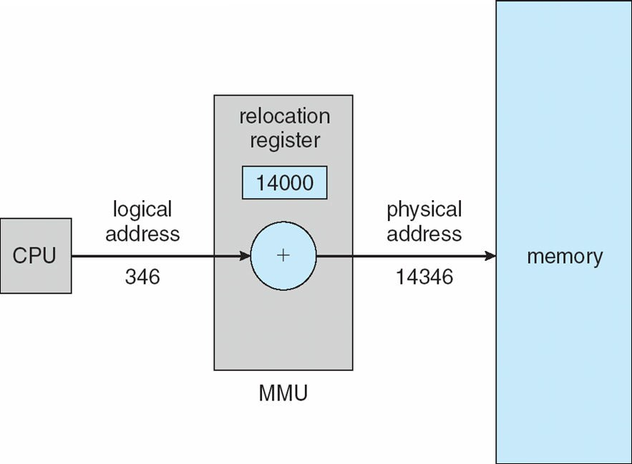
Dynamic Relocation Using a Relocation Register
s

Slide 9
Swapping
A process can be swapped temporarily out of memory to a backing store, and then brought back into memory for continued execution.
Backing store – fast disk large enough to accommodate copies of all memory images for all users; must provide direct access to these memory images.
Roll out, roll in – swapping variant used for priority- based scheduling algorithms; lower-priority process is swapped out so higher-priority process can be loaded and executed

Slide 10
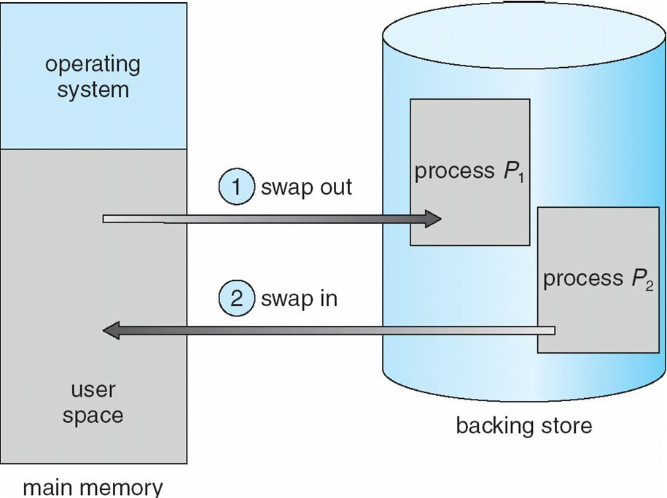
Schematic View Of Swapping
s

Slide 11
Swapping
Major part of swap time is transfer time; total transfer time is directly proportional to the amount of memory swapped
System maintains a ready queue of ready-to-run processes which have memory images on disk

Slide 12
Contiguous Allocation
Main memory usually into two partitions:
Resident operating system, usually held in low memory with interrupt vector
User processes then held in high memory
Relocation registers used to protect user processes from each other, and from changing operating- system code and data
Base register contains value of smallest physical address
Limit register contains range of logical addresses – each logical address must be less than the limit register
MMU maps logical address dynamically

Slide 13
Contiguous Allocation (Cont)
Multiple-partition allocation
Hole – block of available memory; holes of various size are scattered throughout memory
When a process arrives, it is allocated memory from a hole large enough to accommodate it
Operating system maintains information about:
a)allocated partitions
b) free partitions (hole)

Slide 14
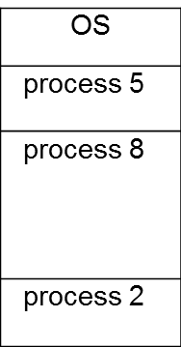
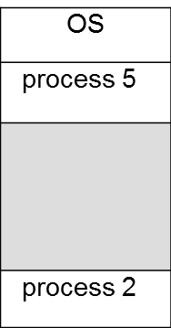
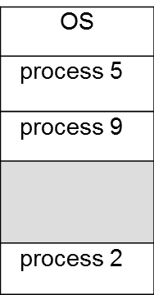
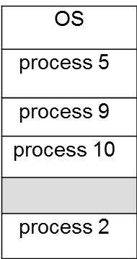
Contiguous Allocation (Cont)

Slide 15
Dynamic Storage-allocation Problem
How to satisfy a request of size n from a list of free holes
First-fit: Allocate the first hole that is big enough
Best-fit: Allocate the smallest hole that is big enough; must search entire list, unless ordered by size produces the smallest leftover hole
Worst-fit: Allocate the largest hole; must also search entire list Produces the largest leftover hole
First-fit and best-fit better than worst-fit in terms of speed and storage utilization

Slide 16
Fragmentation
As processes are loaded and removed from memory, the free memory space is broken into little pieces. It happens after sometimes that processes cannot be allocated to memory blocks considering their small size and memory blocks remains unused. This problem is known as Fragmentation.

Slide 17
Fragmentation—2 Types
Internal fragmentation (Non-contiguous)
Memory block assigned to process is bigger. Some portion of memory is left unused, as it cannot be used by another process.
Worst fit
2. External fragmentation(Contiguous )
Total memory space is enough to satisfy a request or to reside a process in it, but it is not contiguous, so it cannot be used.
First fit, best fit

Slide 18
FRAGMENTATION
External Fragmentation – total memory space exists to satisfy a request, but it is not contiguous
Internal Fragmentation – allocated memory may be slightly larger than requested memory; this size difference is memory internal to a partition, but not being used
Reduce external fragmentation by compaction
Shuffle memory contents to place all free memory together in one large block
Compaction is possible only if relocation is dynamic, and is done at execution time
May lead to I/O problem

Slide 19
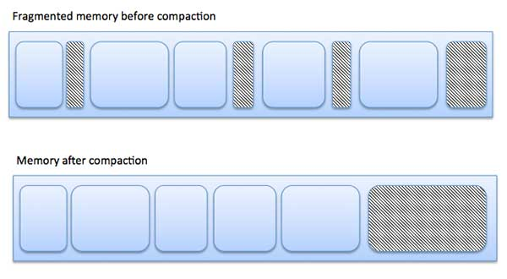

Slide 20
Paging
Logical address space of a process can be noncontiguous; process is allocated physical memory whenever the latter is available
Divide physical memory into fixed-sized blocks called frames (size is power of 2, between 512 bytes and 8,192 bytes)
Divide logical memory into blocks of same size called pages
Keep track of all free frames

Slide 21
Paging
To run a program of size n pages, need to find n free frames and load program
Set up a page table to translate logical to physical addresses
Internal fragmentation may occur in the last frame

Slide 22
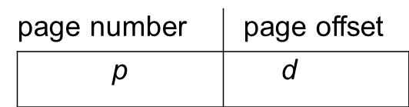
Address Translation Scheme
Address generated by CPU is divided into:
Page number (p) – used as an index into a page table which contains base address of each page in physical memory
Page offset (d) – combined with base address to define the physical memory address that is sent to the memory unit
For given logical address space 2^{m} and page size 2^{n}
m - n
n

Slide 23
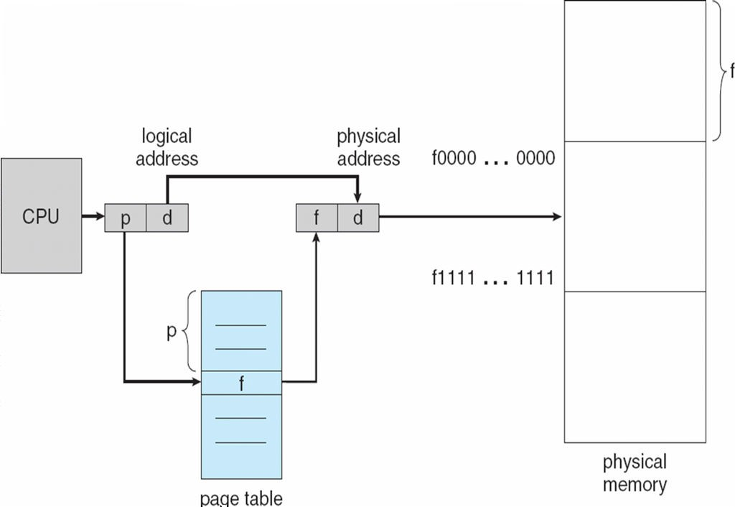
Paging Hardware
a

Slide 24
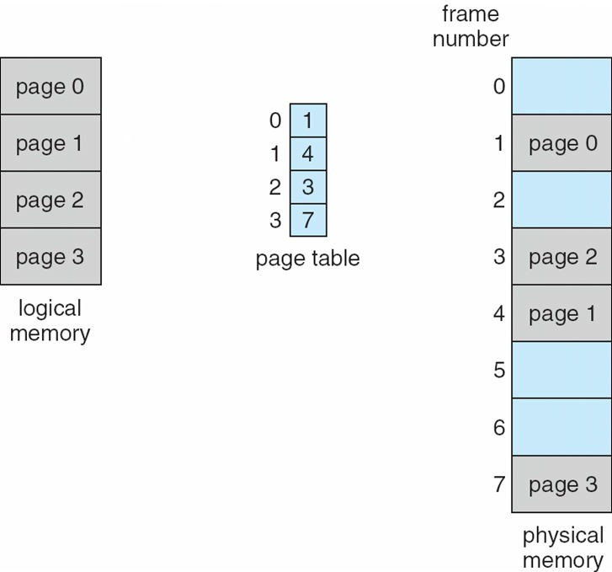
Paging Model Of Logical And Physical Memory
z

Slide 25
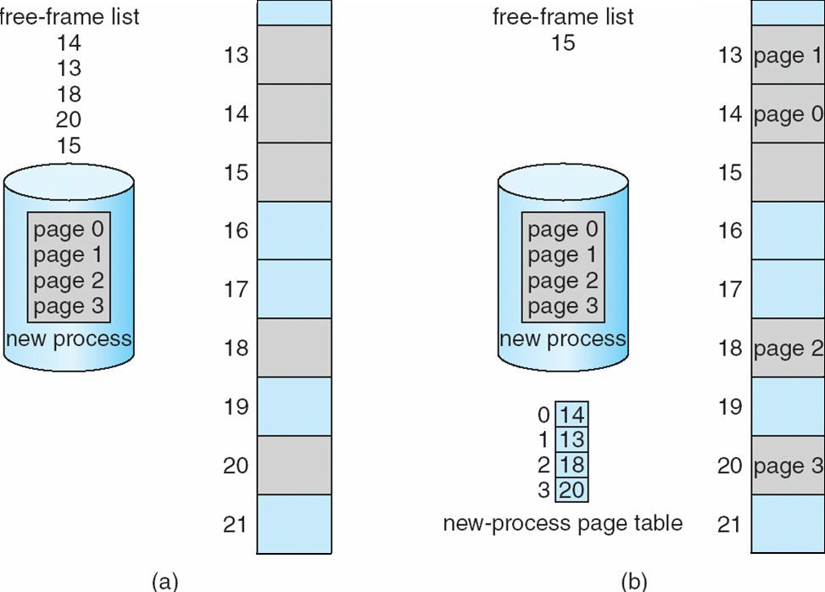
Free Frames
Before allocation
After allocation

Slide 26
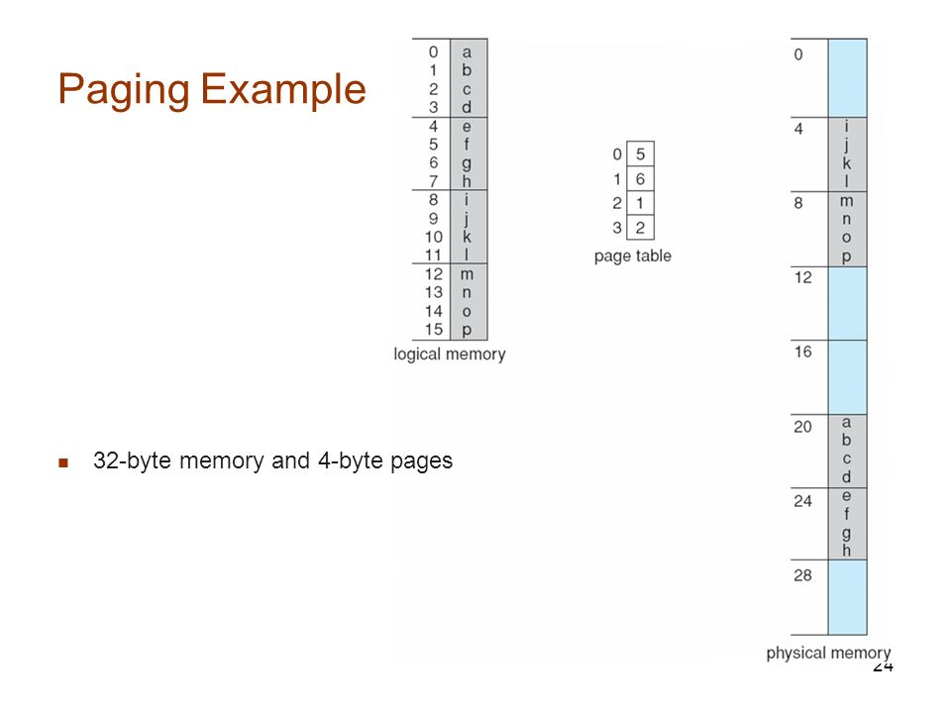

Slide 27
Logical Address=0, ie page=0
offset=0
Physical address=(5*4)+0=20
2) Logical Address=3, ie page=0
offset=3
Physical address=(5*4)+3=23
3) Logical Address=4, ie page=1
offset=0
Physical address=(6*4)+0=24
4) Logical Address=13, ie page=3
offset=1
Physical address=(2*4)+1=9

Slide 28
Implementation Of Page Table
Page table is kept in main memory.
Page-table base register (PTBR) points to the page table.
Page-table length register (PRLR) indicates size of the page table.
In this scheme every data/instruction access requires two memory accesses. One for the page table and one for the data/instruction.
The two memory access problem can be solved by the use of a special fast-lookup hardware cache called associative memory or translation look-aside buffers (TLBs).
Some TLBs store address-space identifiers (ASIDs) in each TLB entry – uniquely identifies each process to provide address-space protection for that process.

Slide 29
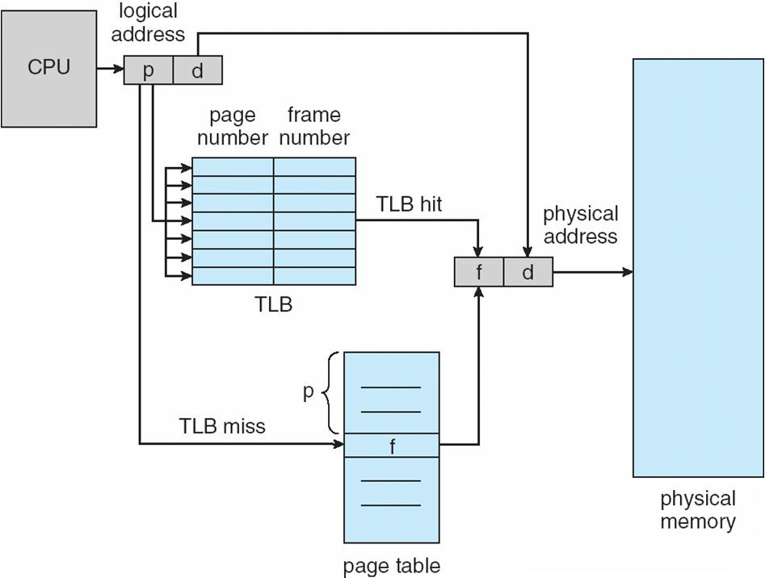
Paging Hardware With TLB
.

Slide 30
Structure of the page table
Hierarchical Paging
Hashed Page Table
Inverted Page Table

Slide 31
1.Hierarchical Page Tables
Break up the logical address space into multiple page tables
A simple technique is a two-level page table

Slide 32
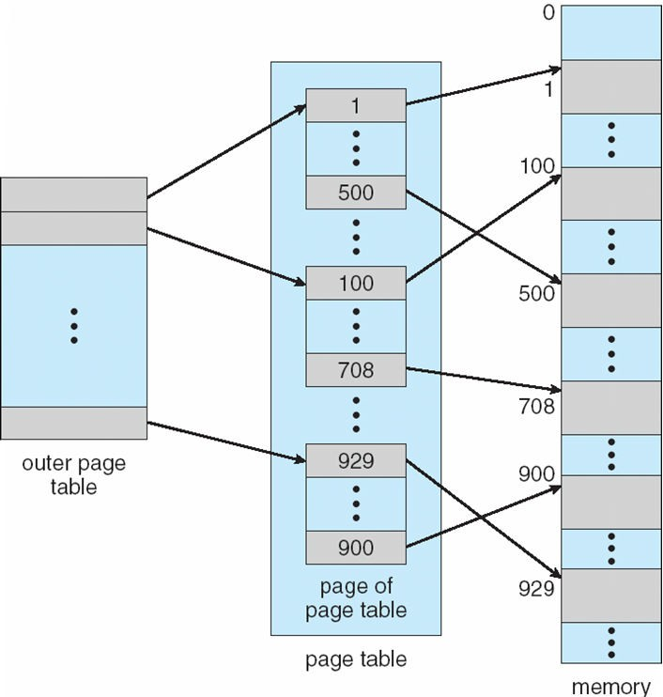
Two-level Page-table Scheme
.

Slide 33
Two-level Paging Example
A logical address (on 32-bit machine with 1K page size) is divided into:
a page number consisting of 22 bits
a page offset consisting of 10 bits
a page number consisting of 22 bits a page offset consisting of 10 bits
a 12-bit page number
a 10-bit page offset

Slide 34
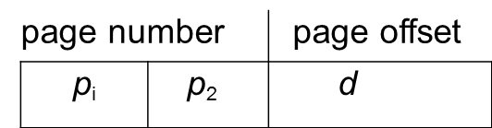
Two-level Paging Example
Thus, a logical address is as follows:
where p_{i} is an index into the outer page table, and p₂ is the displacement within the page of the outer page table
12
10
10

Slide 35
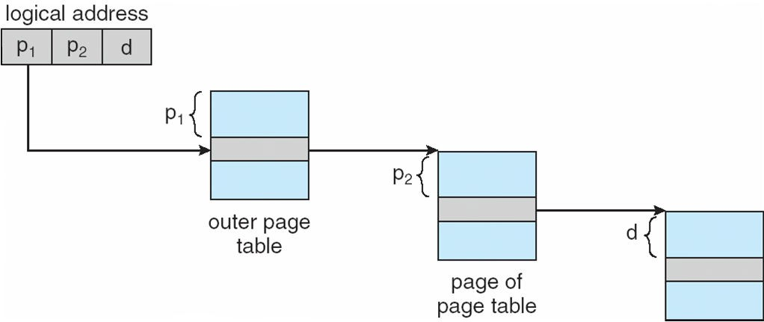
Address-translation Scheme
.

Slide 36
2.Hashed Page Tables
Common in address spaces > 32 bits
The virtual page number is hashed into a page table
This page table contains a chain of elements hashing to the same location
Virtual page numbers are compared in this chain searching for a match
If a match is found, the corresponding physical frame is extracted

Slide 37
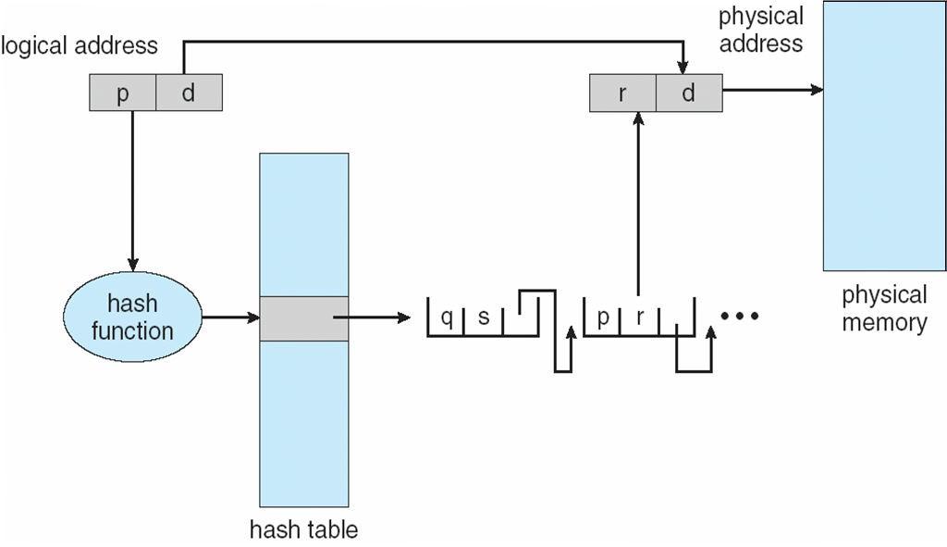
2. Hashed Page Table
.

Slide 38
3. Inverted Page Table
One entry for each real page of memory
Entry consists of the virtual address of the page stored in that real memory location, with information about the process that owns that page
Decreases memory needed to store each page table, but increases time needed to search the table when a page reference occurs
Use hash table to limit the search to one
— or at most a few — page-table entries

Slide 39
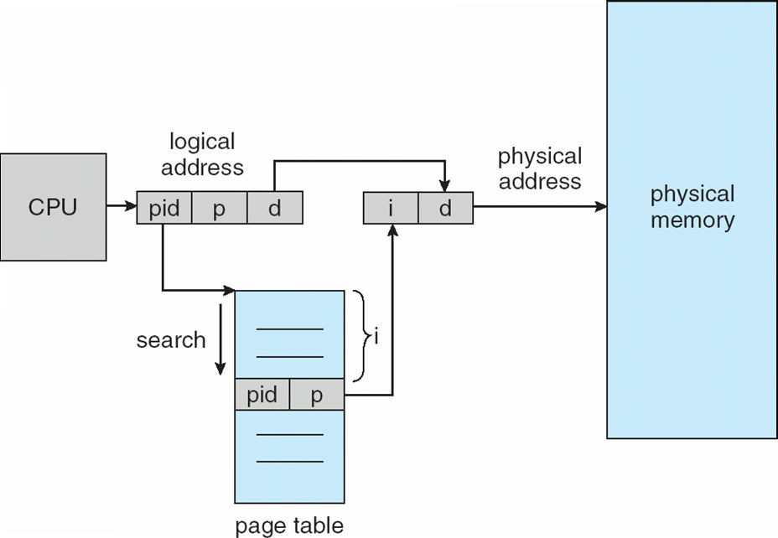
3.Inverted Page Table Architecture
.

Slide 40
Segmentation
Memory-management scheme that supports user view of memory
A program is a collection of segments
A segment is a logical unit such as:
main program function method
object
local variables, global variables common block
stack arrays

Slide 41
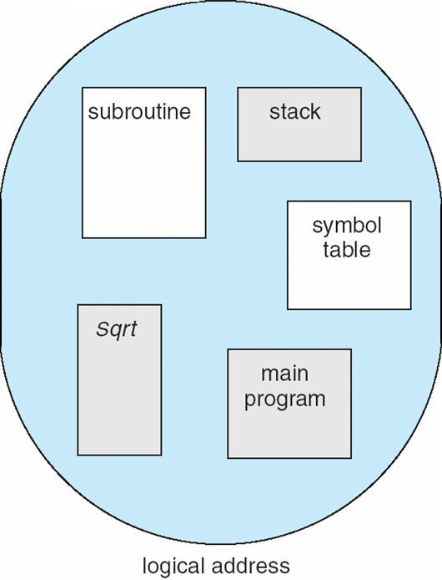
User’s view of a program
.

Slide 42
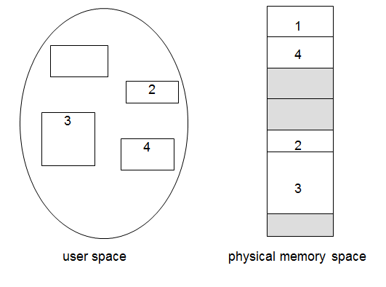
Logical View Of Segmentation

Slide 43
Segmentation Architecture
Logical address consists of a two tuple:
<segment-number, offset>,
Segment table – maps two-dimensional physical addresses; each table entry has:
base – contains the starting physical address where the segments reside in memory
limit – specifies the length of the segment
Segment-table base register (STBR) points to the segment table’s location in memory
Segment-table length register (STLR)
indicates number of segments used by a program

Slide 44
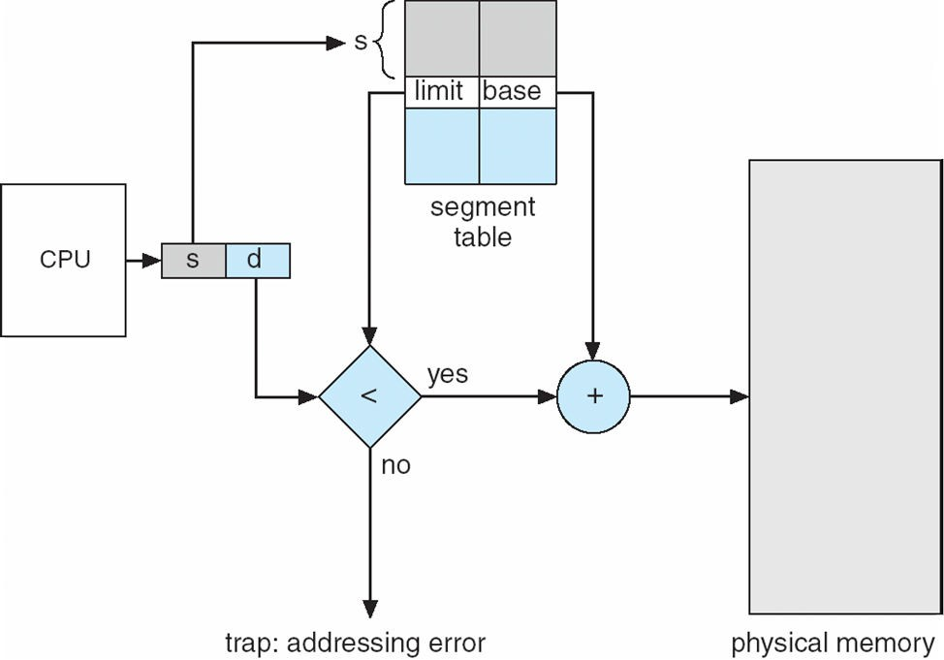
Segmentation Hardware
.

Slide 45
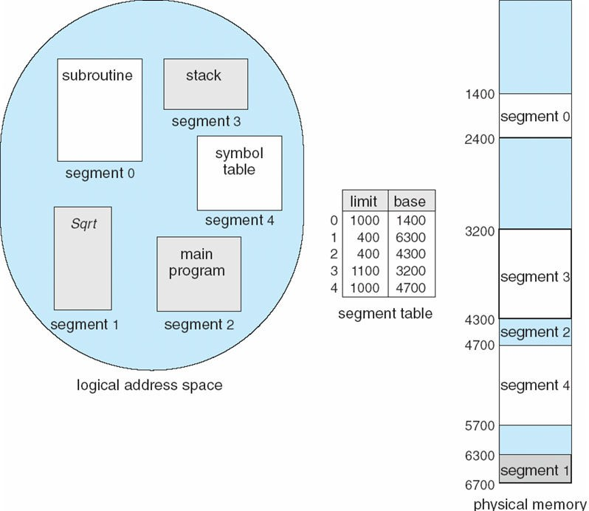
Example Of Segmentation
.

Slide 46
VIRTUAL MEMORY

Slide 47
BACKGROUND
Code needs to be in memory to execute, but entire program rarely used
Error code, unusual routines, large data structures
Entire program code not needed at same time
Consider ability to execute partially-loaded program
Virtual memory is imaginary memory: it gives you the illusion of a memory arrangement that’s not physically there.

Slide 48
Virtual memory – separation of user logical memory from physical memory
Only part of the program needs to be in memory for execution
Logical address space can therefore be much larger than physical address space
Allows address spaces to be shared by several processes
Allows for more efficient process creation
More programs running concurrently
Less I/O needed to load or swap processes
Virtual memory can be implemented via:
Demand paging
Demand segmentation

Slide 49
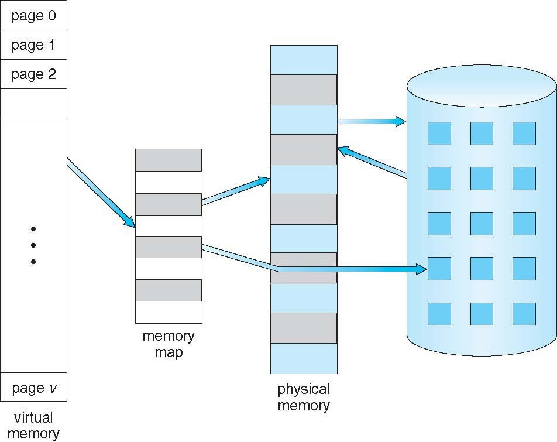
Virtual memory that is larger than physical memory
.

Slide 50
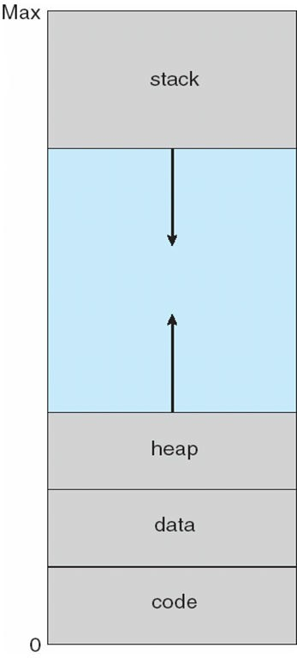
Virtual-address Space
.

Slide 51
Demand Paging
Bring a page into memory only when it is needed
Less I/O needed, no unnecessary I/O
Less memory needed
Faster response
More users
Page is needed ⇒ reference to it
invalid reference ⇒ abort
not-in-memory ⇒ bring to memory
Lazy swapper – never swaps a page into memory unless page will be needed
Swapper that deals with pages is a pager

Slide 52
Valid-invalid Bit
With each page table entry a valid–invalid bit is associated
(v ⇒ in-memory – memory resident,
i ⇒ not-in-memory)
Initially valid–invalid bit is set to i on all entries
During address translation, if valid–invalid bit in page table entry is i⇒ page fault

Slide 53
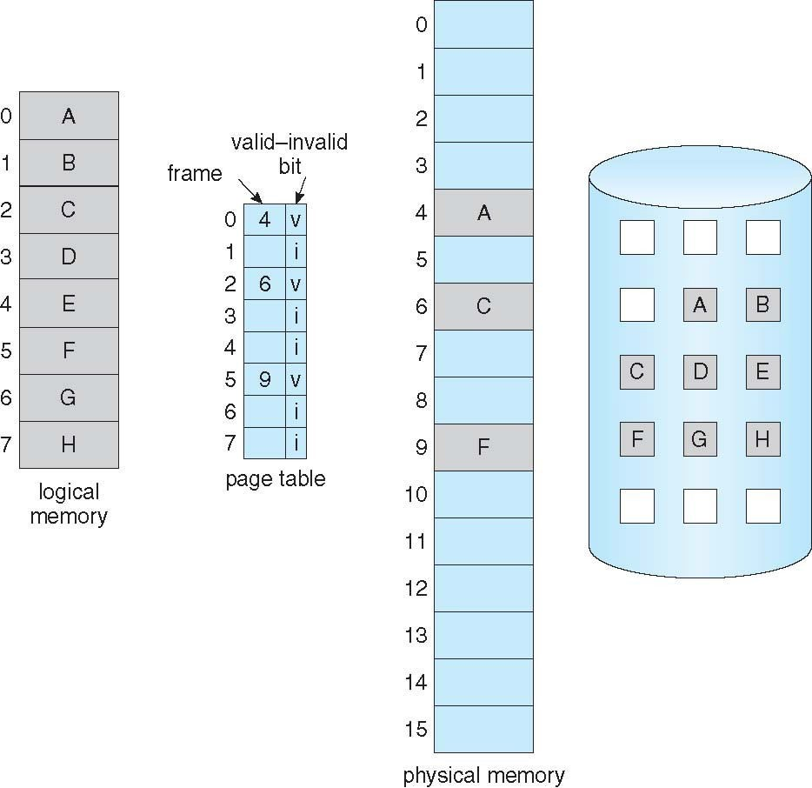
Page table when some pages are not in main memory
.

Slide 54
Steps in handling page fault
If there is a reference to a page, first reference to that page will trap to operating system:
page fault
Operating system looks at another table to decide:
Invalid reference ⇒ abort
Just not in memory
Get empty frame
Swap page into frame via scheduled disk operation
Reset tables to indicate page now in memory Set validation bit = v
Restart the instruction that caused the page fault

Slide 55
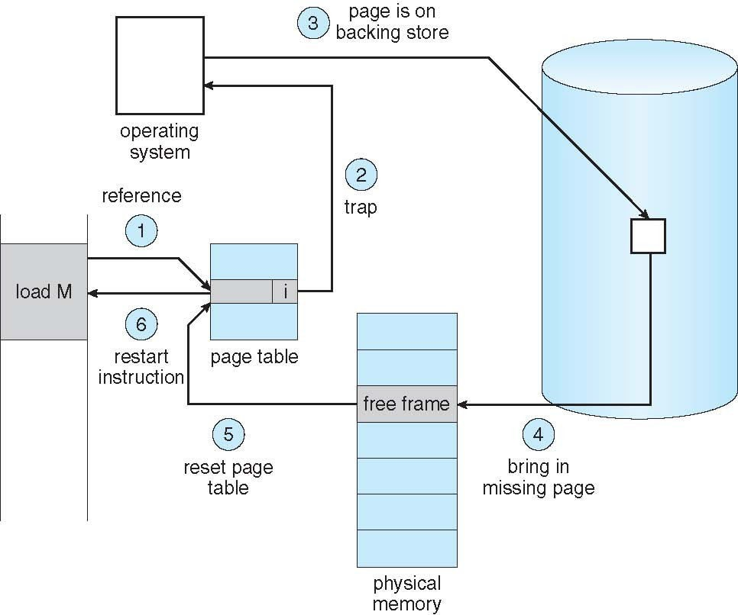
Steps in handling a page fault
.

Slide 56
demand paging
Extreme case – start process with no pages in memory - Pure demand paging

Slide 57
Page Replacement
Prevent over-allocation of memory by modifying page-fault service routine to include page replacement
Use modify (dirty) bit to reduce overhead of page transfers – only modified pages are written to disk
Page replacement completes separation between logical memory and physical memory – large virtual memory can be provided on a smaller physical memory

Slide 58
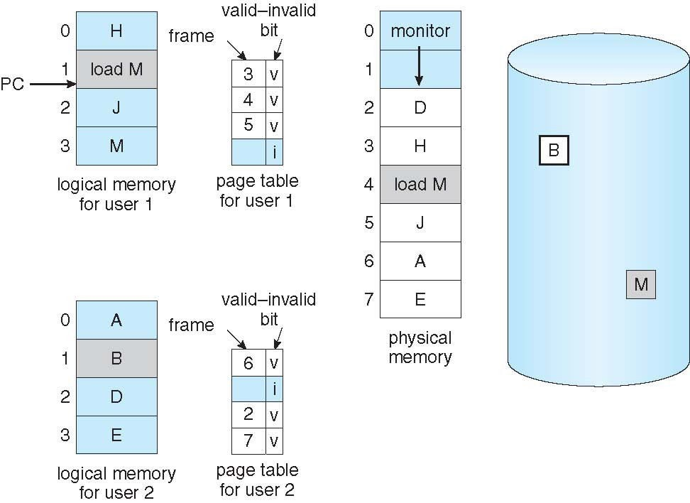
Need For Page Replacement
.

Slide 59
Basic page replacement
Find the location of the desired page on disk.
Find a free frame:
If there is a free frame, use it.
If there is no free frame, use a page replacement algorithm to select a victim frame.
Write the victim frame to the disk ;change the page and frame tables accordingly.
Read the desired page into the newly freed frame; update the page and frame tables.
Restart the user process.

Slide 60
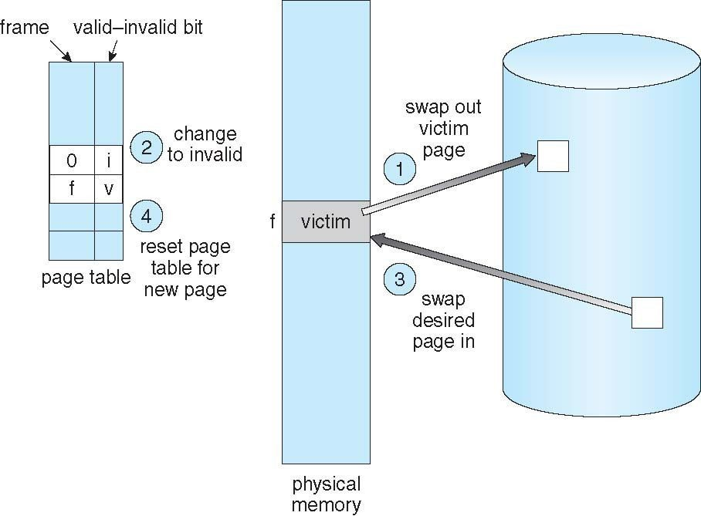
Page Replacement
.

Slide 61
Page and frame replacement algorithms
Frame-allocation algorithm determines
How many frames to give each process
Which frames to replace
Page-replacement algorithm
Want lowest page-fault rate on both first access and re- access
Evaluate algorithm by running it on a particular string of memory references (reference string) and computing the number of page faults on that string
String is just page numbers, not full addresses
Repeated access to the same page does not cause a page fault

Slide 62
Page Replacement Algorithms
FIFO Page Replacement
Optimal Page Replacement
LRU (Least Recently Used) Page Replacement

Slide 63
FIRST-IN-FIRST-OUT (FIFO) ALGORITHM
The reference string 7,0,1,2,0,3,0,4,2,3,0,3,0,3,2,1,2,0,1,7,0,1
3 frames (3 pages can be in memory at a time per process)
3 frames---15 page faults
4 frames—10 page faults

Slide 64
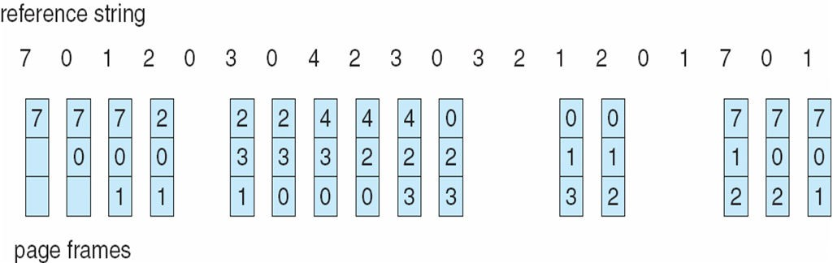
FIFO PAGE REPLACEMENT
.

Slide 65
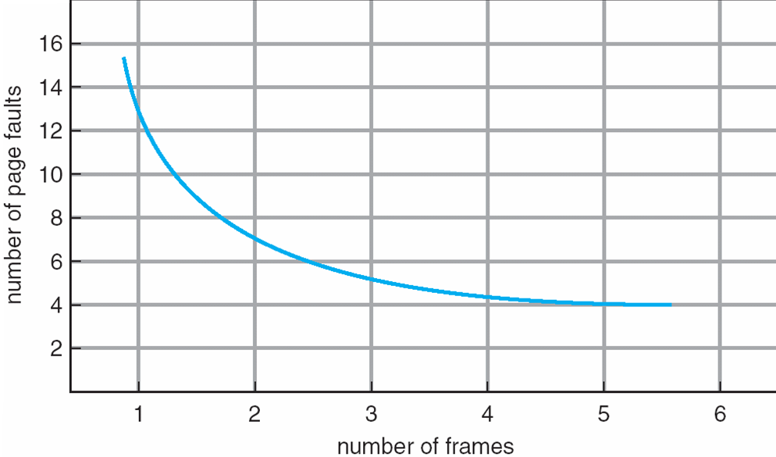
Graph of Page Faults Versus The Number of Frames

Slide 66
FIRST-IN-FIRST-OUT (FIFO) ALGORITHM
Can vary by reference string: consider 1,2,3,4,1,2,5,1,2,3,4,5
Adding more frames can cause more page faults!
Belady’s Anomaly
Ex—3 frames = 9 page faults
4 frames = 10 page faults

Slide 67
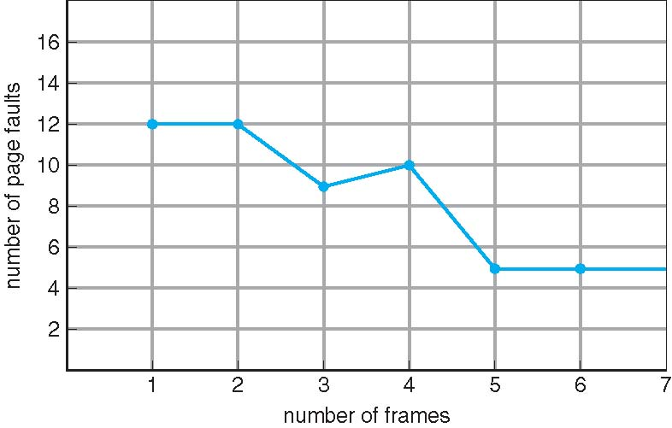
FIFO Illustrating Belady’s Anomaly

Slide 68
2.Optimal Page Replacement
Replace page that will not be used for longest period of time
9 is optimal for the example on the next slide

Slide 69
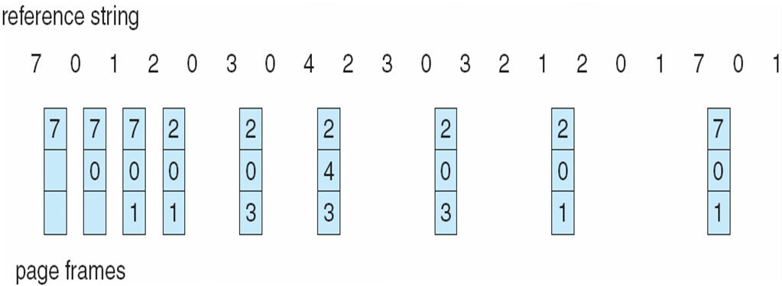
OPTIMAL PAGE REPLACEMENT
.

Slide 70
3.Least Recently Used (LRU) Algorithm
Use past knowledge rather than future
Replace page that has not been used in the most amount of time
Associate time of last use with each page.
12 faults – better than FIFO but worse than OPT
Generally good algorithm and frequently used

Slide 71
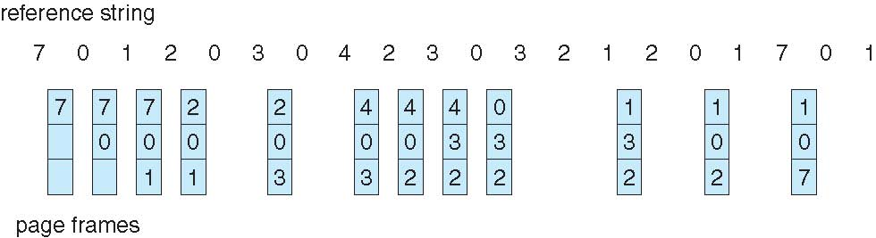
3. Least Recently Used (LRU) Algorithm

Slide 72
Thrashing
If a process does not have “enough” pages, the page-fault rate is very high
Page fault to get page
Replace existing frame
But quickly need replaced frame back
This leads to:
Low CPU utilization
Operating system thinking that it needs to increase the degree of multiprogramming
Another process added to the system
Thrashing ≡ a process is busy swapping pages in and out

Slide 73
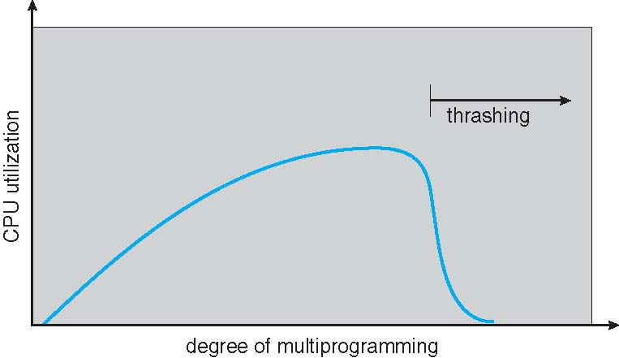
Thrashing (Cont.)

Slide 74
THRASHING
Thrashing ≡ Excessive Paging operation takes place or a process is busy swapping pages in and out

